Slide 1
Design Patterns. Factory

Slide 2
Table of content
Intent
Problem
Discussion
Structure
Example

Slide 3
Intent
Provide an interface for creating families of related or dependent objects without specifying their concrete classes.
A hierarchy that encapsulates: many possible "platforms", and the construction of a suite of "products".
The new operator considered harmful.

Slide 4
Problem
If an application is to be portable, it needs to encapsulate platform dependencies. These "platforms" might include: windowing system, operating system, database, etc. Too often, this encapsulation is not engineered in advance, and lots of #ifdef case statements with options for all currently supported platforms begin to procreate like rabbits throughout the code.

Slide 5
Discussion
Provide a level of indirection that abstracts the creation of families of related or dependent objects without directly specifying their concrete classes. The "factory" object has the responsibility for providing creation services for the entire platform family. Clients never create platform objects directly, they ask the factory to do that for them.
This mechanism makes exchanging product families easy because the specific class of the factory object appears only once in the application - where it is instantiated. The application can wholesale replace the entire family of products simply by instantiating a different concrete instance of the abstract factory.
Because the service provided by the factory object is so pervasive, it is routinely implemented as a Singleton.

Slide 6
Discussion
The protocol described above specifies a "pull" interaction model. Instead of the Subject "pushing" what has changed to all Observers, each Observer is responsible for "pulling" its particular "window of interest" from the Subject. The "push" model compromises reuse, while the "pull" model is less efficient.
Issues that are discussed, but left to the discretion of the designer, include: implementing event compression (only sending a single change broadcast after a series of consecutive changes has occurred), having a single Observer monitoring multiple Subjects, and ensuring that a Subject notify its Observers when it is about to go away.
Notes:
The Observer pattern captures the lion's share of the Model-View-Controller architecture that has been a part of the Smalltalk community for years.

Slide 7
Structure
The Abstract Factory defines a Factory Method per product. Each Factory Method encapsulates the new operator and the concrete, platform-specific, product classes. Each "platform" is then modeled with a Factory derived class.

Slide 8
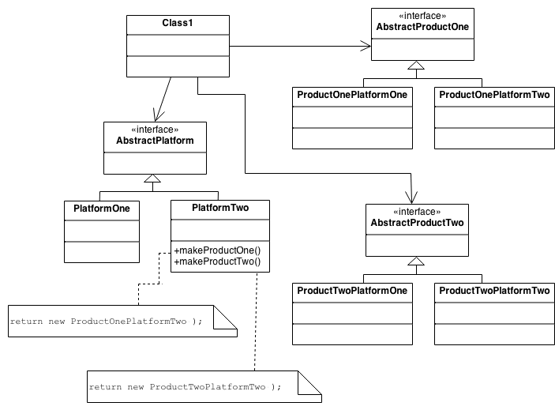
Structure

Slide 9
Example
The purpose of the Abstract Factory is to provide an interface for creating families of related objects, without specifying concrete classes. This pattern is found in the sheet metal stamping equipment used in the manufacture of Japanese automobiles. The stamping equipment is an Abstract Factory which creates auto body parts. The same machinery is used to stamp right hand doors, left hand doors, right front fenders, left front fenders, hoods, etc. for different models of cars. Through the use of rollers to change the stamping dies, the concrete classes produced by the machinery can be changed within three minutes.

Slide 10
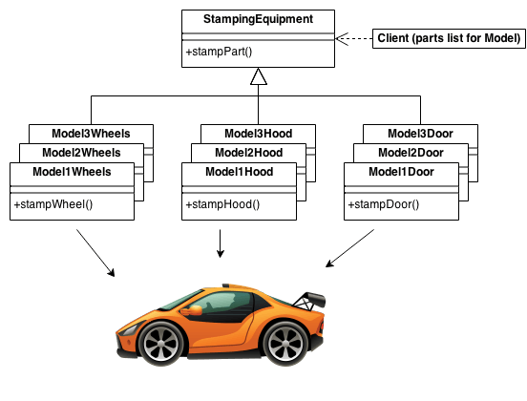
Example

Slide 11
Check list
Decide if "platform independence" and creation services are the current source of pain.
Map out a matrix of "platforms" versus "products".
Define a factory interface that consists of a factory method per product.
Define a factory derived class for each platform that encapsulates all references to the new operator.
The client should retire all references to new, and use the factory methods to create the product objects.

Slide 12
Rules of thumb
Sometimes creational patterns are competitors: there are cases when either Prototype or Abstract Factory could be used profitably. At other times they are complementary: Abstract Factory might store a set of Prototypes from which to clone and return product objects, Builder can use one of the other patterns to implement which components get built. Abstract Factory, Builder, and Prototype can use Singleton in their implementation.
Abstract Factory, Builder, and Prototype define a factory object that's responsible for knowing and creating the class of product objects, and make it a parameter of the system. Abstract Factory has the factory object producing objects of several classes. Builder has the factory object building a complex product incrementally using a correspondingly complex protocol. Prototype has the factory object (aka prototype) building a product by copying a prototype object.

Slide 13
Rules of thumb
Abstract Factory classes are often implemented with Factory Methods, but they can also be implemented using Prototype.
Abstract Factory can be used as an alternative to Facade to hide platform-specific classes.
Builder focuses on constructing a complex object step by step. Abstract Factory emphasizes a family of product objects (either simple or complex). Builder returns the product as a final step, but as far as the Abstract Factory is concerned, the product gets returned immediately.

Slide 14
Rules of thumb
Often, designs start out using Factory Method (less complicated, more customizable, subclasses proliferate) and evolve toward Abstract Factory, Prototype, or Builder (more flexible, more complex) as the designer discovers where more flexibility is needed.

